Slide 1

Identification & Classification Of Rice Species Using Image Processing & Soft Computing Techniques
JALPAIGURI GOVERNMENT ENGINEERING COLLEGE
(COMPUTER SCIENCE & ENGINEERING)
Project Supervisor :
Mr. Dhiman Mondal
Presented by :
Swarna Kamal Dhyawala
Ankit Srivastava
Souvik Pal
Pema Lamu Bhutia

Slide 2
: OUTLINE OF THE PRESENTATION :
SL No. | Content | Slide no.
1. | Problem Statement | 3
2. | Purpose of Project | 4
3. | Introduction | 5
4. | Literature Review | 6
5. | Other Related Work | 7
6. | Architecture of Rice Grain Identification | 8
7. | Image Acquisition | 9
8. | Image Pre-Processing | 10-11
9. | Feature Extraction | 12
10. | Feature Selection | 13
11. | Classification | 14-17
12. | Future Work | 18
13. | Bibiliography | 19-20
14. | Acknowledgement | 21

Slide 3
: PROBLEM STATEMENT :
Rice is essential food to live in India and it has more than 40,000 varieties.
India is the third leading producer of rice in the entire world.
The domestication of rice ranks as one of the most important developments in history and now thousands of rice varieties are cultivated on every continent except Antarctica.
Our aim is to classify the rice grains based on the feature which we will extract.
The intension of this work is to develop a real time application which was used to identify and classify of the rice grains.

Slide 4
: OTHER RELATED WORK :
Ref. Index | Features Used | Tech Used | No. of Images | Success Rate
1. | Major & Minor Axis Length , Area | Not Clearly Mentioned | 105 | 93%
2. | Major & Minor Axis Length, Aspect Ratio, Orientation | Measure Parameter Value | 1509 | Not Mentioned
3. | Perimeter, Area, Major & Minor Axis Length | Based on feature | Not Mentioned | Not Mentioned
4. | Length, width, Perimeter, Compactness Ratio | Morphological Processing | 95 | Not Mentioned
5. | Area, Major & Minor Axis Length | Neural Network | 20 | 91.3%
6. | Major & Minor Axis Length, Area, Perimeter, Eccentricity | Mahalanobis Distance | 40 | Not Mentioned
7. | Length, Eccentricity, Major & Minor Axis Length | Based on dimention | 22 | 98.7%
8. | Area, Major & Minor Axis Length, Centroid | Based on Size | 100 | Not Mentioned
9. | Height, Width, Area, Mean, Convex Area, Angle, Perimeter, Angle Back, Eccentricity, Standard Deviation | Image Processing | 1000 | 60%

Slide 5
: ARCHITECTURE OF RICE VARIETY IDENTIFICATION :
An Architecture of proposed rice grain identification system is shown below :
Image Acquistion
Noise Removal
Image Rotation
Cropping
Training & Testing
Classification
Feacture Selection
Feature Extraction

Slide 6
: IMAGE ACQUISITION :
The images of 27 rice varieties which consists 100 images of each varieties are collected for the project work. Among which we are taking 9 varieties : Sabraj, Radhni Pagal, Pakistani Basmati, Madhmala, Kte Patnai, Kamal, Jabra, Hirva Juha, Haranana, Danti.
The data were collected from BIDHAN CHANDRA KRISHI VISWAVIDYALAYA and the camera used for taking images is TUCSEN (USB 2.0 H Series) with Resolution : 1271 X 952 and Magnification 0.9 (9 times).

Slide 7
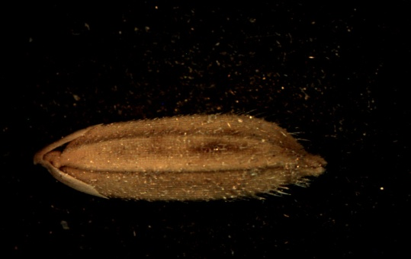
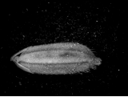
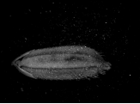
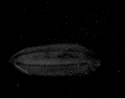
: IMAGE PRE-PROCESSING :
GREEN
BLUE
RED
Original Image
2. RGB CHANNEL
3. We have selected RED CHANNEL on the basis of clarity.

Slide 8
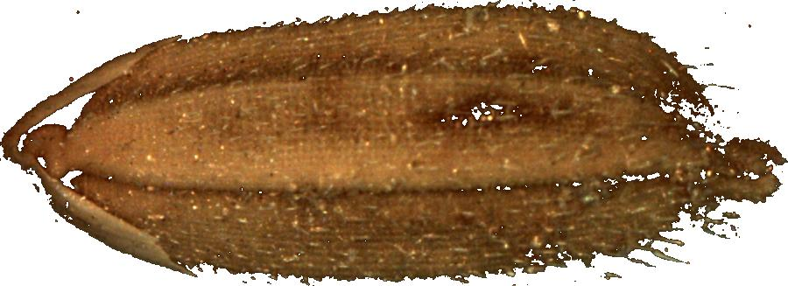
: IMAGE PRE-PROCESSING :
Binarization of the image.
Noise removal is done with connected component analysis and the biggest area pixel is choosen among them.
Images are rotated to bring it in same Orientation.
Final Image

Slide 9
: FEATURE EXTRACTION :
: Morphological feature :
Angle
Angle Back
Area
Perimeter
Eccentricity
Solidity
Centroid
Convex Area
Width
Height
Rectangularity
Circularity
Major Axis length
Minor Axis length
Extent
Awn

Slide 10
: FEATURE EXTRACTION :
: Texture Feature :
Energy
Mean
Standard Deviation
Correlation
Entropy
Contrast
Homogenity

Slide 11
: FEATURE SELECTION :
:Spearman Algorithm :
The Spearman's rank-order correlation is the nonparametric version of the Pearson product-relation correlation. Spearman's correlation coefficient, (ρ, also signified by r_{s}) measures the strength and direction of association between two ranked variables..
Feature Selection:-
Angle from front
Eccentricity
Entropy
Contrast
Homogeneity
Centroid
Rectangularity
Circularity
Extent
Angle from back
Area
Awn
Minor Axis Length
Major Axis Length
Mean
Solidity

Slide 12
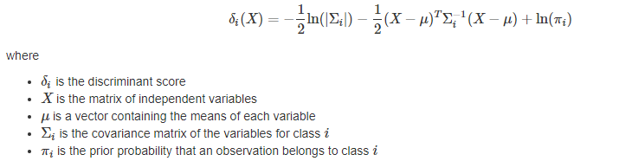
: CLASSIFICATION :
:Quadratic Discriminant Analysis:
A quadratic classifier is used in machine learning and statistical classification to separate measurements of two or more classes of objects or events by a quadric surface. It is a more general version of the linear classifier.
The QDA classifier assumes that the observations from each class of Y are drawn from a Gaussian distribution. QDA assumes that each class has its own covariance matrix. It finds a quadratic function of the independent variables.

Slide 13
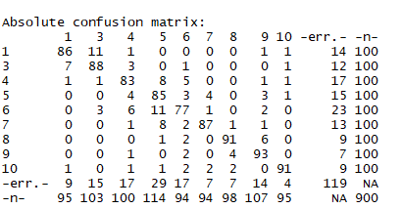
:RESULTS & DISCUSSIONS:
This section illustrate the accuracy and evolution matrix for the selected features of multilleveled dataset. The rice variety dataset contains 15 features and 900 objects of 9 varieties.
Confusion Matrix obtained from R Studio

Slide 14
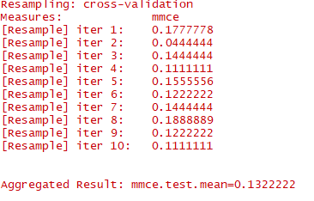

:RESULTS & DISCUSSIONS (CONTINUED) :
10 Fold Cross Validation

Slide 15
: Result & Discussion :
Sl No. | ALGORITHM USED | ERRORS
1 | RANDOM FOREST | 80.77%
2 | NEURAL NETWORK | 83%
3 | MARS | 84.7%
4 | QUADRATIC DISCRIMINANT ANALYSIS | 86.78%

Slide 16
: CROSS VALIDATION RESULTS :
Ref. Index | Features Used | Tech Used | No. of Image | Success Rate
1. 2. 3. 4. | Major & Minor Axis Length, Area Area, Major & Minor Axis Length Length, Eccentricity, Major & Minor Axis Length Morphological & Texture Feature (Proposed Method) | Not clearly Mentioned Neural Network Based on Dimension Image Processing & Soft Computing | 105 20 22 900 (9 variety) | 93% 91.3% 98.7% 86.78%

Slide 17
: FUTURE WORK :
The preliminary work presented here could be further enhanced by focusing on different sampling methods, sample sizes, sample pre-processing techniques, different features and different machine learning models to match the requirements of the rice industry.
In this project, we have worked with various morphological processes on rice species and extracting features using image processing. This method is computationally efficient with more accurate result than the other existing methods. Using Matlab we efficiently worked with various inbuilt functions which help to get expected outcomes. All this lead to better classify and identify rice grains.

Slide 18
: BIBILIOGRAPHY :
Vidya Patil, V. S. Malemath,” Quality Analysis and Grading of Rice Grain Images” International Journal of Innovative Research in Computer and Communication Engineering (An ISO 3297: 2007 Certified Organization), Volume 3, Issue 6, June 2015.
Sukhvir Kaur, Derminder Singh .” Geometric Feature Extraction of Selected Rice Grains using Image Processing Techniques” International Journal of Computer Applications (0975–8887)Volume 124– No.8, August 2015. 322(10):891–921, 1905.
Neelamegam, P., Abirami, S. Vishnu Priya, K. Rubalya Valantina, S.” Analysis of Rice Granules using Image Processing and Neural Network Pattern Recognition Tool” Information Communication Technologies (ICT), IEEE Conference , 879-884 , 11-12 April 2013.
Ajay, G., Suneel, M., Kumar, K.K., Prasad, P.S.: quality Evaluation of Rice Grains Using Morphological Methods. In: International Journal of Soft Computing and Engineering (IJSCE), 2(1), (2013).

Slide 19
: BIBILIOGRAPHY (CONTINUED) :
Anusha A., Shabari S. B.: “Classification and Identification of rice grains using Neural Network” International Journal of Innovative Research in Computer and Communication Engineering (An ISO 3297: 2007 Certified Organization), Volume 4, Issue 4, April 2014.
Abirami. S, Neelamegam. P,Kala.H “Analysis of Rice Granules using Image Processing and Neural Network Pattern Recognition Tool” International Journal of Computer Applications (0975–8887) Volume 96 – No.7, June 201
Abirami. S, Neelamegam. P,Kala.H “Analysis of Rice Granules using Image Processing and Neural Network Pattern Recognition Tool” International Journal of Computer Applications (0975–8887) Volume 96 – No.7, June , 2014.
Neelam, Jyoti G., “Identification and Classification of Rice varieties using Mahalanobis Distance by Computer Vision” International Journal of Scientific and Research Publications (ISSN 2250-3153), Volume 5, Issue 5, May 2015.

Slide 20
: ACKNOWLEGEMENT :
We would like to extend our gratitude to Prof. Dhiman Mondal from the Department of Computer Science & Engineering for his contributions towards the image processing and machine learning components of our system. Furthermore, this project and documentation would never have been more educative and efficient without his constant help and guidance. We would like to thank her for his guidance and for always being a source of encouragement.
We would like to thank the Bidhan Chandra Krishi Viswavidyalaya for consent to collect images of rice grains as a part of our project. We would like to thank Dr.Kushal Rai , who helped us in image acquition process.
We also express our deepest and sincere gratitude to all our teachers especially ​Dr. Dipak Kumar Kole​,​Prof. Chinmoy Ghosh and ​Prof. Srinibas Rana for their kind comments and advice during the different stages of our project. We are also extremely grateful to ​Prof. Subhas Barman, Prof. Animesh Hazra, Prof. Jhuma Dutta and Dr. Amitava Ray(Principal) for their encouragement and support. Last but not least, we would like to thank the librarians of our institution for their constant support.

Slide 21
Thank You . .

